Slide 1


GCA5 School Champion
Notes:
Title Screen

Slide 2
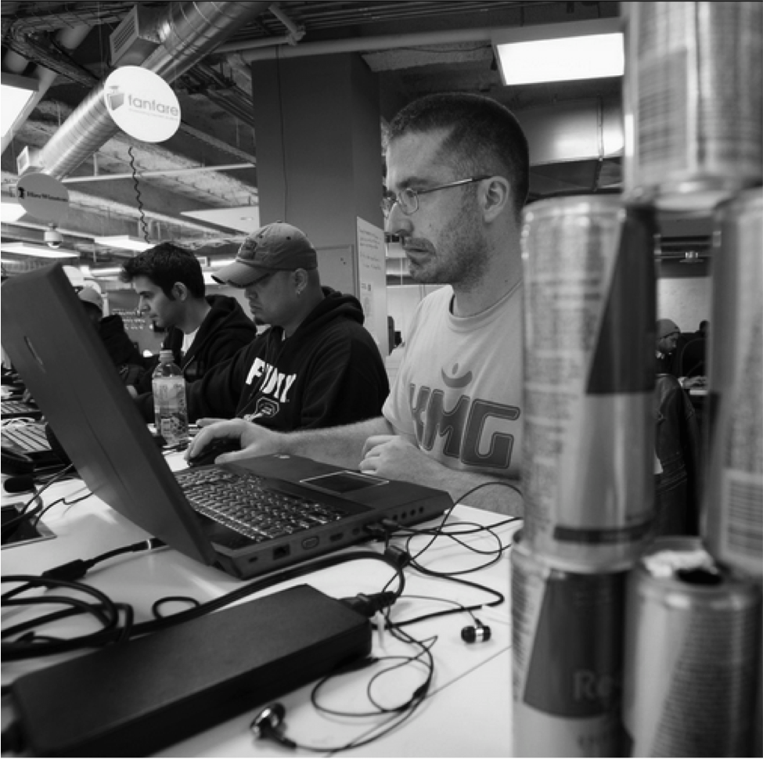
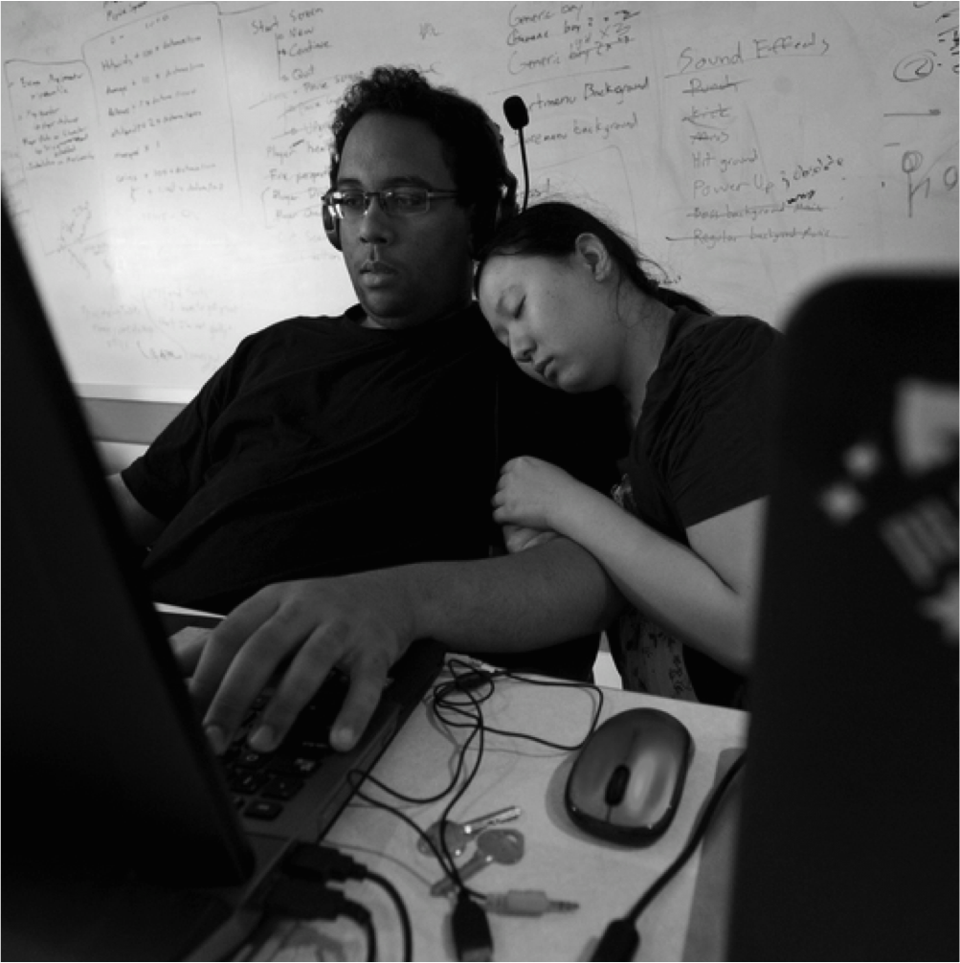
Great Canadian Appathon
The Only National Game Development Hackathon
The Great Canadian Appathon (GCA) was created in 2011 as a way of engaging with and giving back to the student game developer community.
The Great Canadian Appathon (GCA) is a 48-hour national competition open to Canadian college and university students from coast-to-coast. Aspiring game developers race against the clock to design the next hit mobile game.
Since it’s inception, the GCA quickly grew to become a constant in students’ calendars, an annual event where the best computer engineers and game developers test their skills in the field, and at many schools an accredited extracurricular activity.
GCA1
Team Friend Boat, $25,000 Grand Prize winner from the Ontario Institute of Technology.
After refueling with red bull, GCA³ participants are back to hack at the Ryerson DMZ GCA HUB.
Power naps are the way to go at Hackathons. This adorable pair of GCA³ participants is catching some zzzzz’s.
GCA Teams celebrating finishing their games at the University of Toronto HUB.

Slide 3

History of the GCA
GCA
GCA²
GCA³
GCA⁴
Mar 2011
Oct 2011
Sept 2012
Jan 2014
4 Provinces
7 Schools
94 Teams
296 Students
54 Games
All Provinces
40+ Schools
150+ Teams
500+ Students
100+ Games
Largest competitive hackathon in Canada for 4 times running!

Slide 4
School Champion
What is a school Champion
A school champion is a member of an academic institution that will help the GCA team organize and run the GCA HUB on their campus.
Responsibilities include:
Help recruiting students for your HUB
securing a classroom for the GCA to take place in
helping manage the HUB over the hackathon weekend
Why do we need school champions
We need school champions to help us run the GCA HUB on campus on the ground level.
School champions help us reach the student population on campus to help spread the word about the GCA to recruit participants
School champions are at the HUB making sure everything runs smoothly
What do we provide the school champion
Never hosted a hackathon? No worries, its easy! The GCA team will provide school champions everything they need to recruit participants and manage the hackathon HUB
Hackathon Briefing
instructions on how to organize and run a hackathon HUB
Participant recruit package
Event overview
rules and regulations, judging criteria, FAQs and promotional material

Slide 5
GCA Goals/ Value we provide Students
The GCA was created in 2011 as a way of engaging with and giving back to the student game developer community.
GCA Value to students:
Give aspiring game developers the skills and experience required to design and develop a mobile game.
Provide students with an opportunity to gain valuable insights into the video game development industry.
Connect students with to professionals working in the video game industry
“We expect nothing less than the students to emerge from GCA3 with learning more about commercial software development than any other experience in their student careers,” - Bill Marshall, Founder of the Toronto International Film Festival, and a member of the GCA3 judging panel

Slide 6
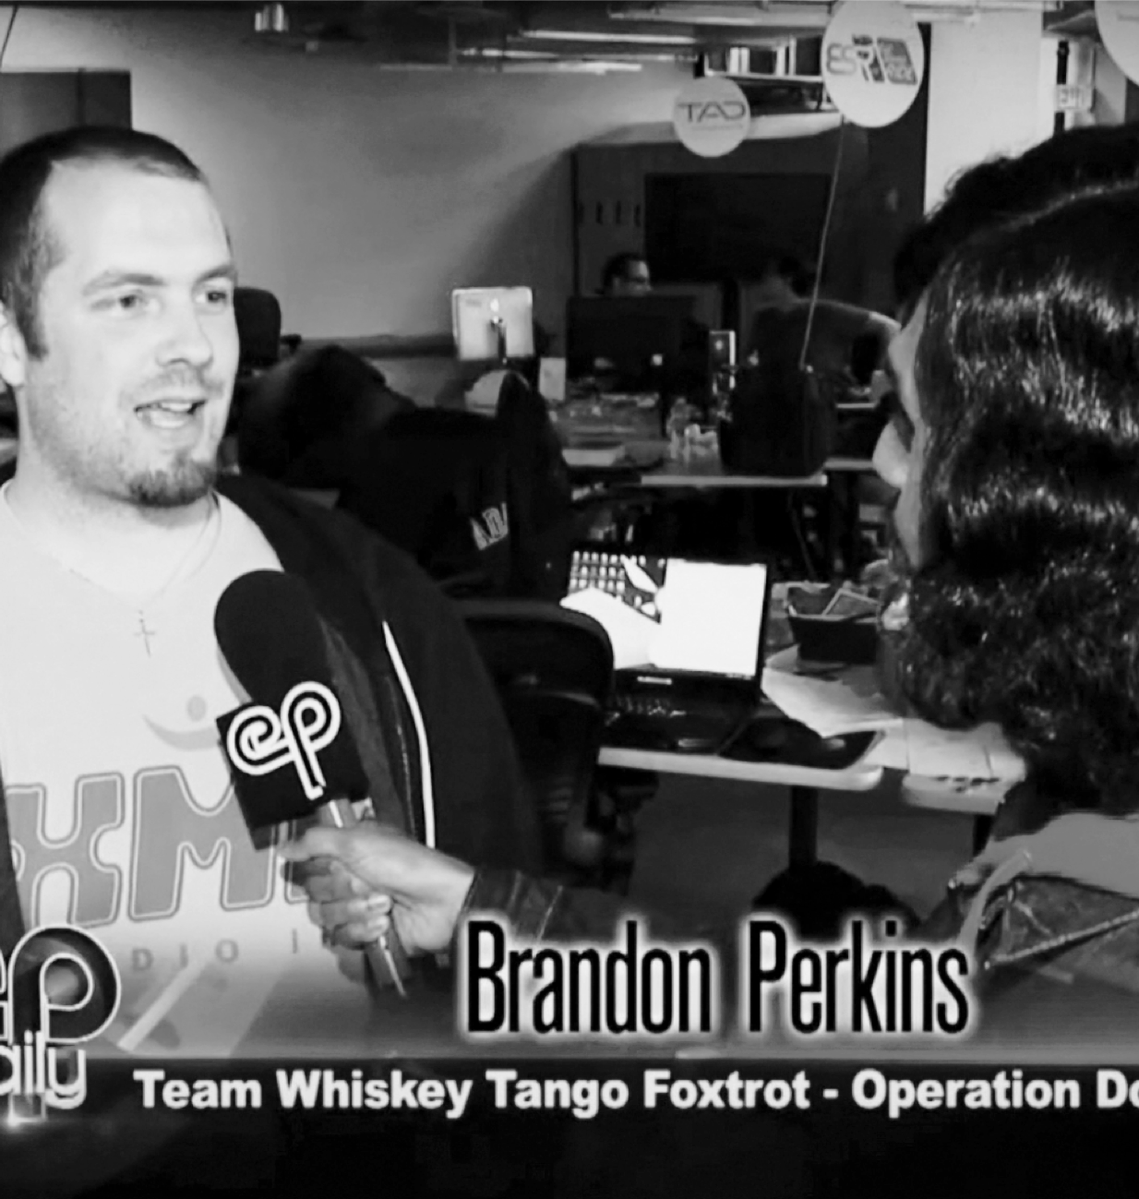











Media
The GCA⁴ had a combined media reach of nearly 8 million and 600,000+ student reach.
GCA³ Hackathon Participant
January 2014, GCA³ Ryerson DMZ HUB, Toronto
Notes:
Photo Layout 2

Slide 7

GCA5
Event Details
WHEN
November 6th - 8th, 2015
PARTICIPATION FORECAST
20 School HUBs
500+ game makers
135+ teams
ESTIMATED GAMES SUBMITTED
130+ games
BUZZ
Targeted media coverage in every province across Canada, and live television coverage from every campus newspaper. Built in custom branding experiences at top 10 HUBS
Notes:
One Column Layout

Slide 8
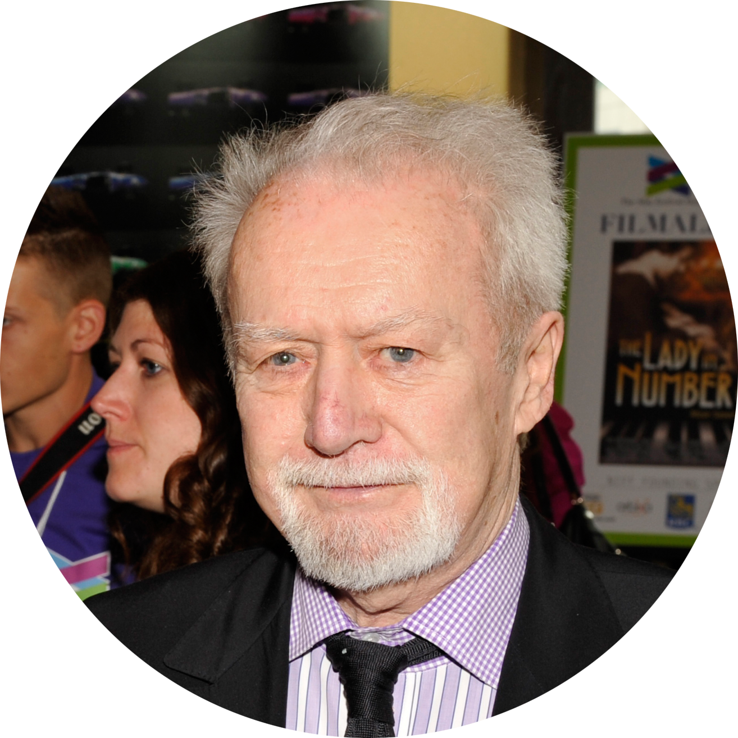
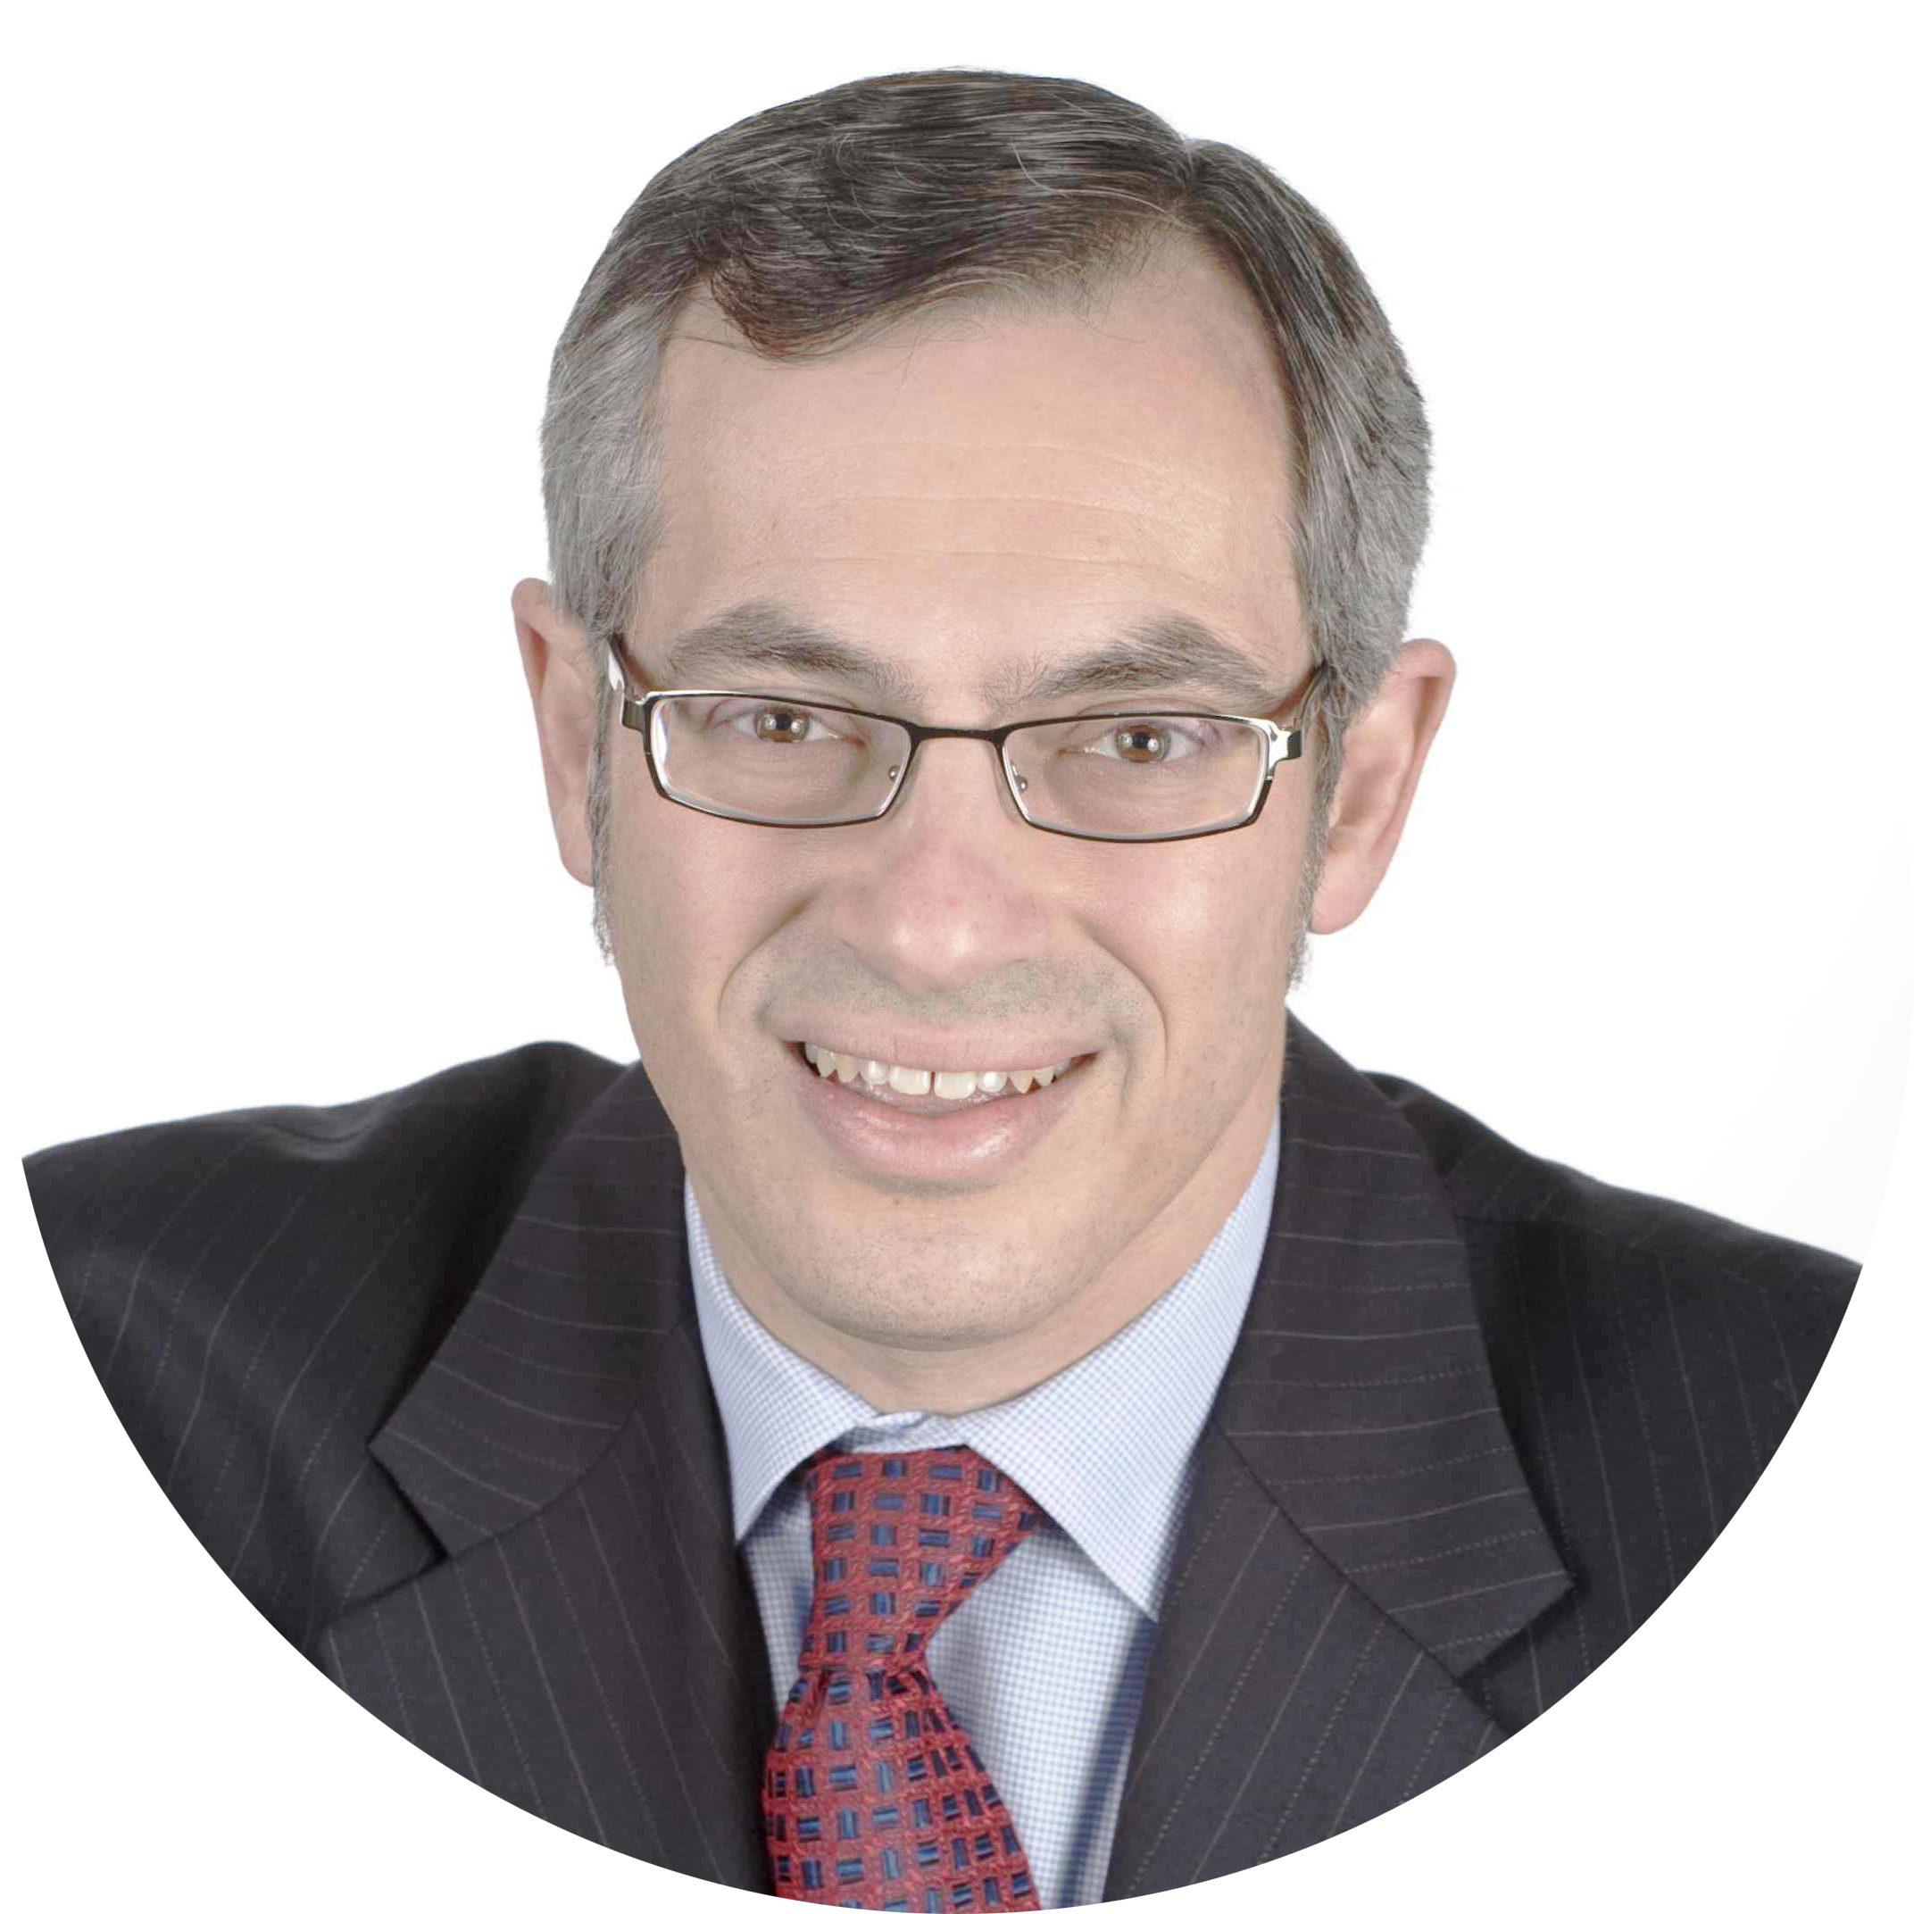
“We expect nothing less than the students to emerge from GCA3 with learning more about commercial software development than any other experience in their student careers,”
Bill Marshall
Founder of the Toronto International Film Festival, and a member of the GCA3 judging panel
”It’s great to see the young Canadian talent we have… the innovation, thinking outside the box… for me, this is a real passion."
Tony Clement
The Hon. Tony Clement, President of Treasury Board of Canada and a member of the GCA4 judging panel
Notes:
Quote Layout 1

Slide 9
WHAT VALUE DOES THE GCA OFFER
XX
We can connect your brand directly with the 18-25 year old university and college student demographic.
We can base the GCA5 theme around your brand which would result in games being built around your brand, or with your brand's elements
We can empower your brand to tap into a new community and expand and strengthen your existing community.
We can get the student demographic to engage with your brand and products
We can provide an opportunity to recruit from this young technically talented group of future graduates
Notes:
One Column Layout

Slide 10
PLATINUM SPONSORSHIP
PLATINUM Level Sponsor $25,000
Branding/naming rights over GCA5
(e.g.Your Co presents: the Great Canadian Appathon 5)
Advisory role in creative execution of GCA5
(think “light touch, high impact”)
Right to pick the GCA theme, allowing you to base all the games created at the GCA around your brand
Includes ALL GOLD level sponsorship perks listed on the next page
Notes:
One Column Layout

Slide 11
GOLD SPONSORSHIP
GOLD Level Sponsor $10,000
Primary recruiting access to all GCA participants
Receive 1 spot on the GCA judging panel
A custom news release will be written about the Gold Sponsors role in making the GCA possible.
Quotes from Gold Sponsor can be included in news release
Gold Sponsor products or services will be integrated into the GCA
Gold Sponsor’s logo will be on all GCA media releases
Gold Sponsor’s logo will be on all GCA signs, banners and printed materials and GCA swag (t-shirts, bags, hats and more)
Gold Sponsor’s logo on all of the official GCA swag
Product placement in GCA swag bags
Gold Sponsor brand integration into GCA social media plan
Notes:
One Column Layout

Slide 12
Participant Experience
“The appathon, in my opinion, was the best way to really put all the information we studied and practiced during class hours into something physical and concrete, something that could be measured and judged in the real world and see what we could accomplish as a team.”
GCA Participant
“You can take courses and develop your programming knowledge, but in a competition you have to think on your feet and troubleshoot quickly – those are very valuable skills”
Professor of Physics & Computer Science at Laurier University
Notes:
Quote Layout 2

Slide 13
THANK YOU FOR YOUR TIME
We’re excited to work with you!
Patti Mikula, Co-Founder & CEO
patti@hackworks.com
Notes:
Thank you slide

